Slide 1




New era of Nuclear Physics
with RI beams
Young Kwan Kwon
2020.6.22~26
핵물리학교 @ on-line

Slide 2
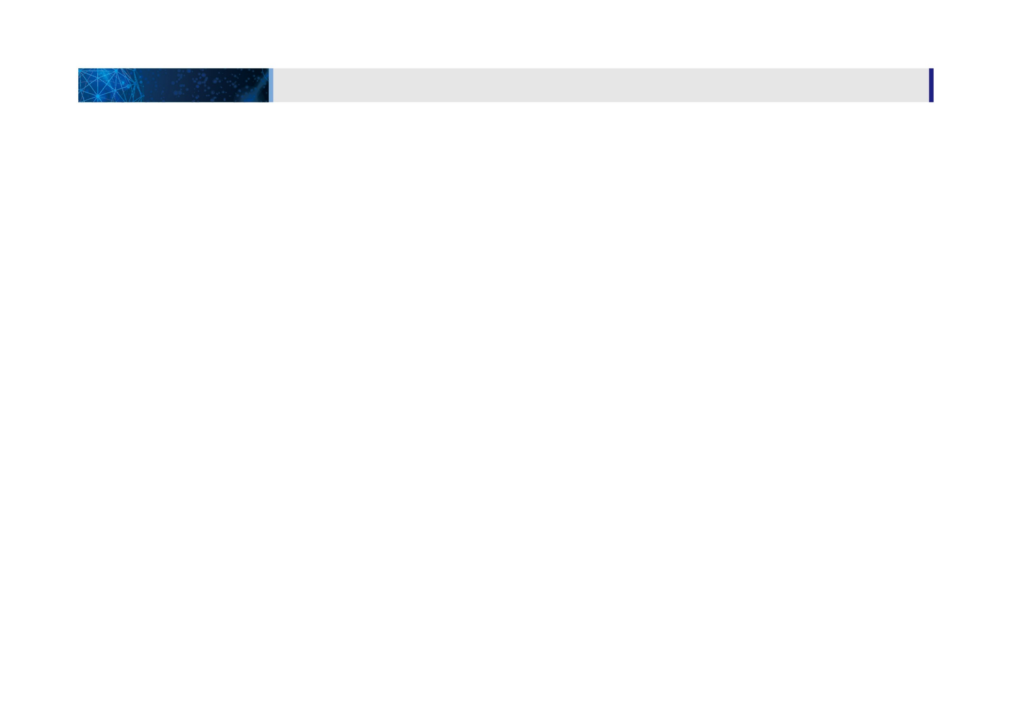
01
1. 일반현황
사업개요 및 내용
사업 일반현황
사업 개요 및 내용
CONTENTS
PART 0. NP with RIBs
PART 1. Project Overview
PART 2. Construction Status
PART 3. System Installation
PART 4. Radiation Safety
PART 5. Summary & Outlook

Slide 3

Part 0.
NP with RIBs

Slide 4
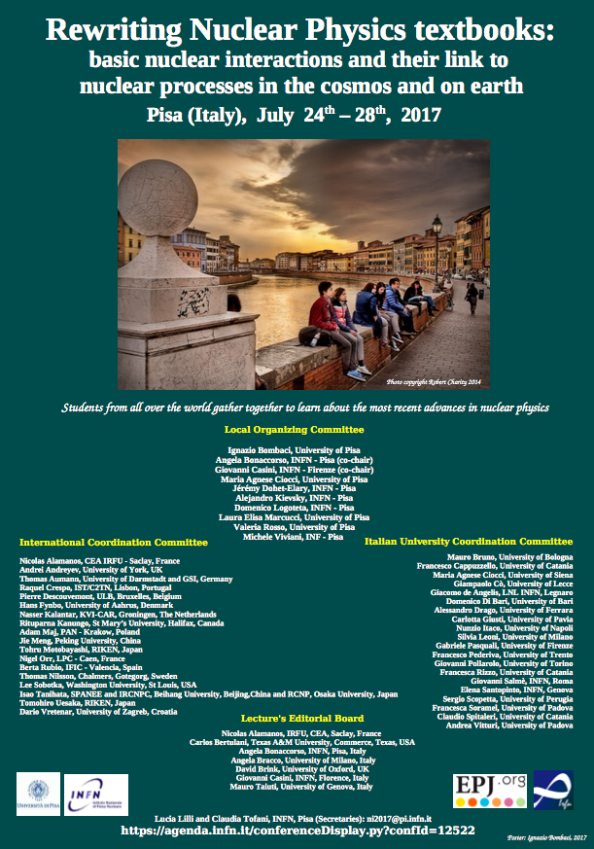
30years anniversary for RIB’S
1. Introduction

Slide 5
Experiments on nuclear physics
1. Introduction
A + B → C + D
beam
target
Until middle of 1980s, beam & target were stable nuclei

Slide 6
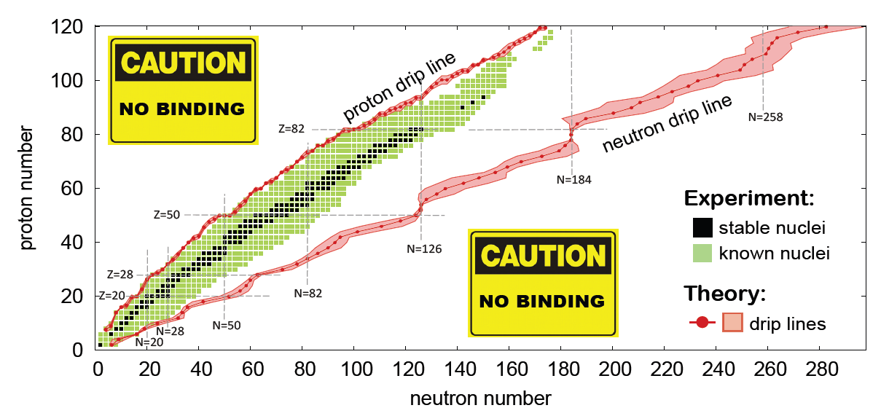
Nuclear Physics with RIB’s: How it all started
1. Introduction
1966 at Lysekil, Sweden & 1970 at CERN, Switzerland
“Symposium on nuclei far from the stability”
Where is the neutron drip line?
Do the nuclear models which were successful for stable nuclei work also for n-rich nuclei?
The relevance to the r-process nucleosynthesis?

Slide 7
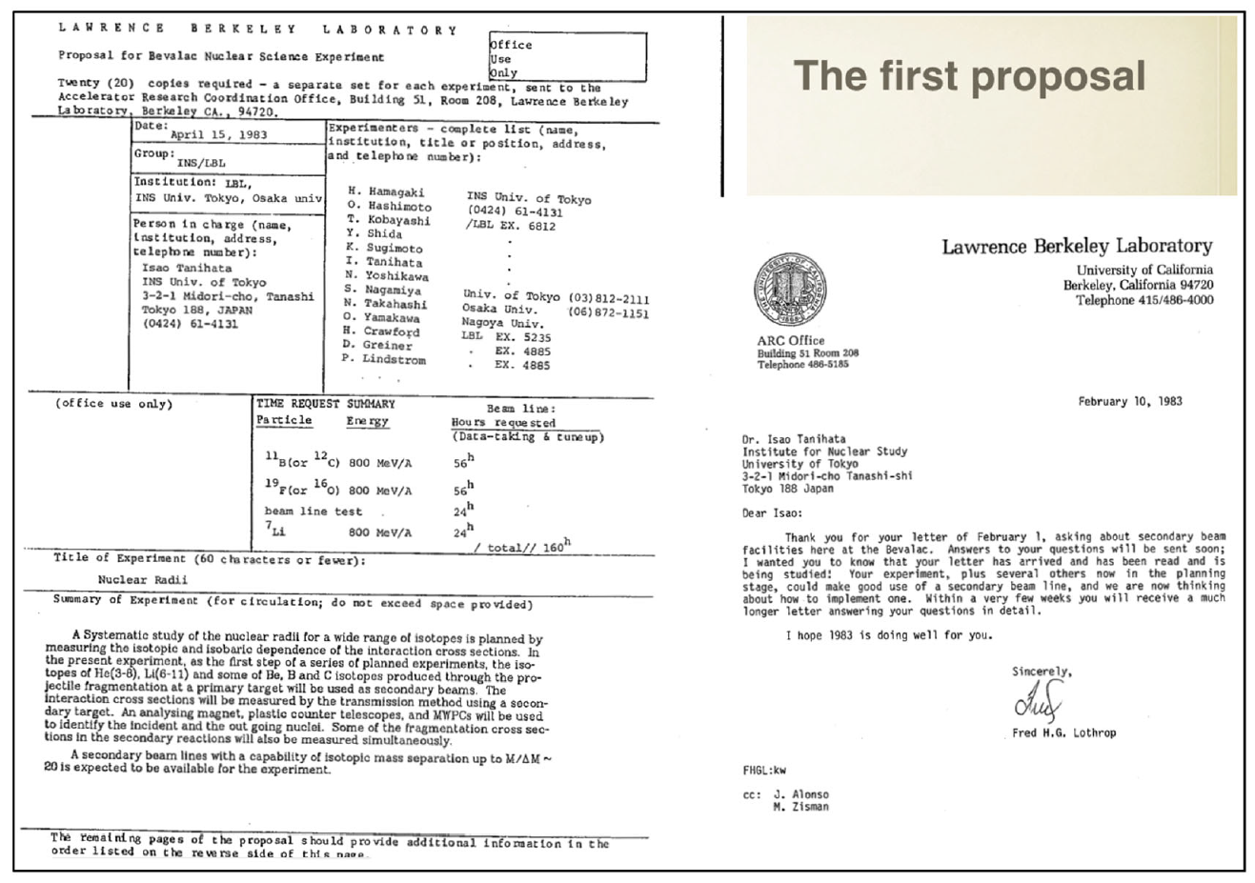
The 1st exp with RIBs: neutron halo (I)
1. Introduction

Slide 8
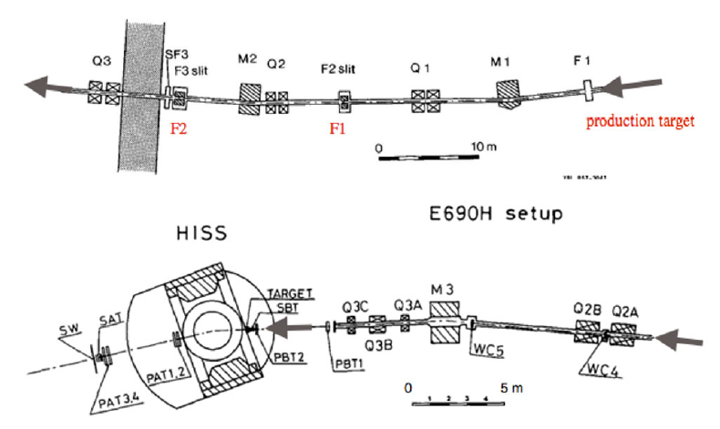
The 1st exp with RIBs: neutron halo (II)
1. Introduction
The 1st secondary beam line at Berkeley

Slide 9
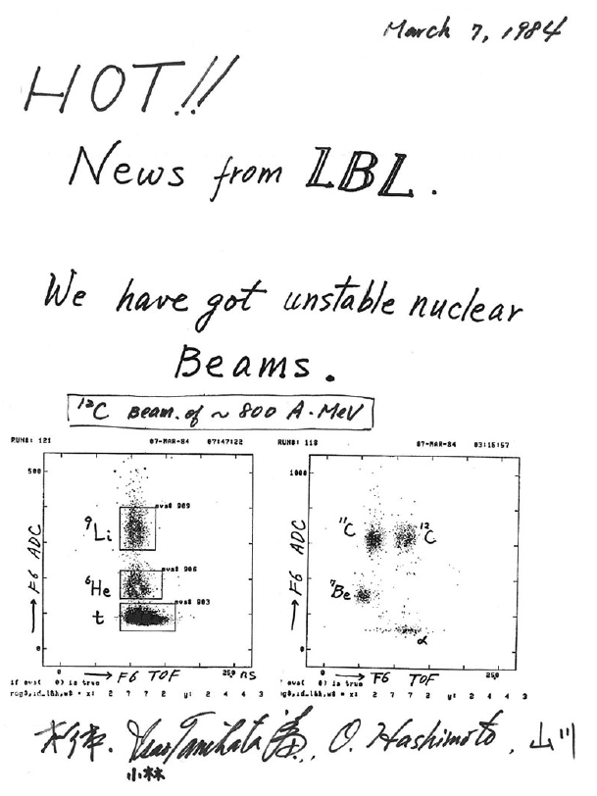
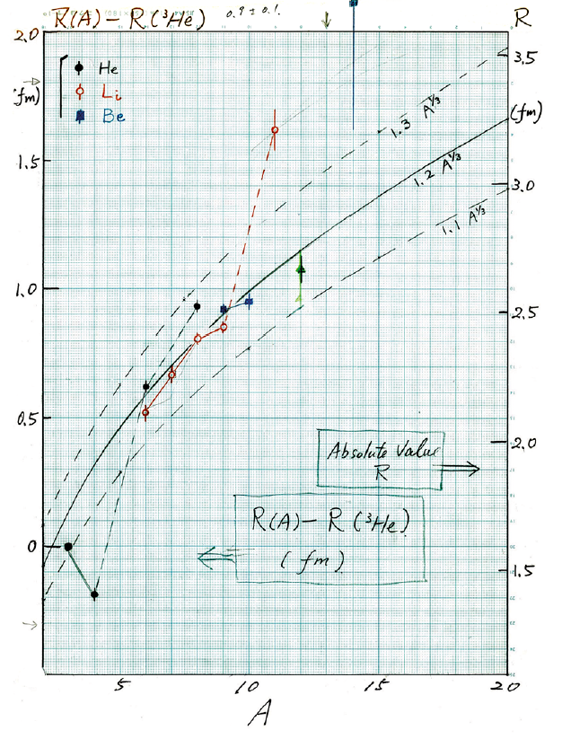
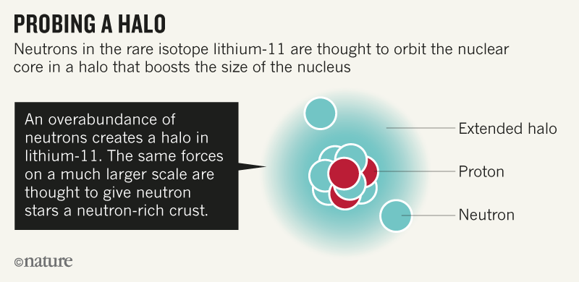
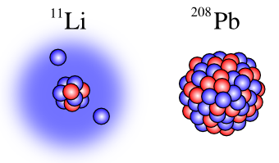
The 1st exp with RIBs: neutron halo (III)
1. Introduction

Slide 10
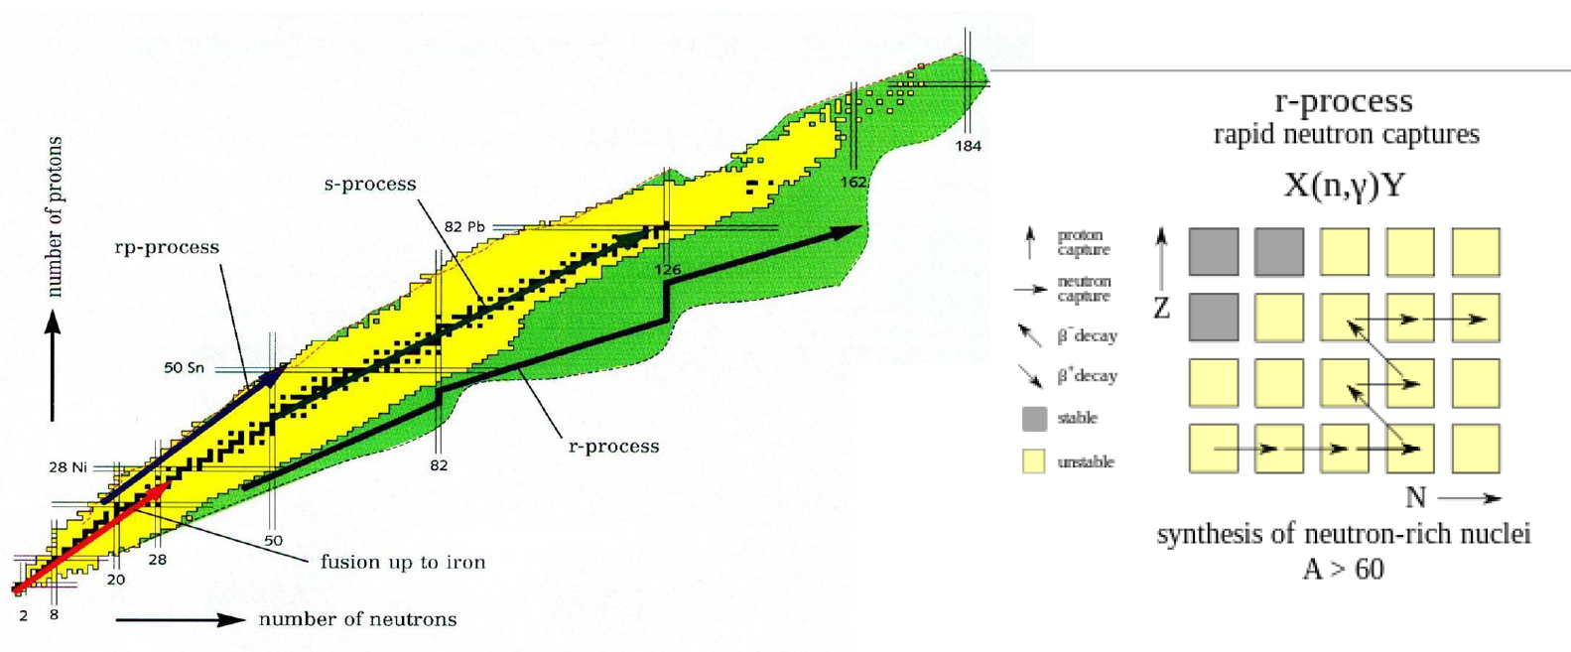
Nuclear astrophysics with RIB’s (I)
1. Introduction
How are the chemical elements made ??
Unstable nuclei are playing a key role
: mass, reaction cross-section, beta decay life time etc…

Slide 11
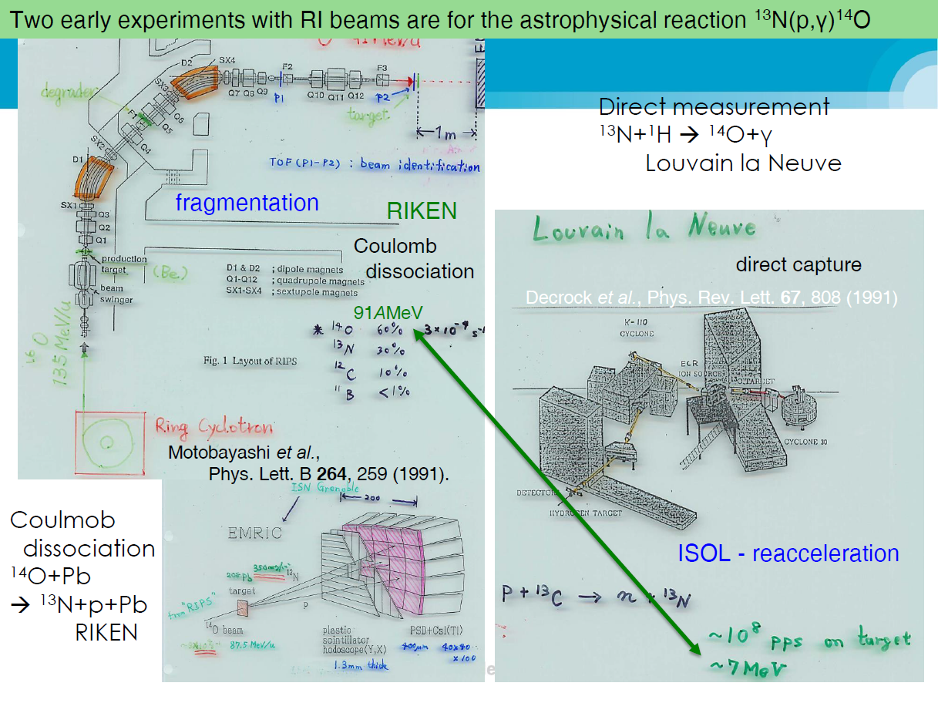
Nuclear astrophysics with RIB’s (II)
1. Introduction

Slide 12
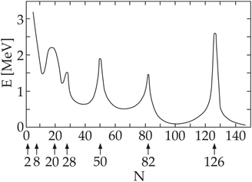
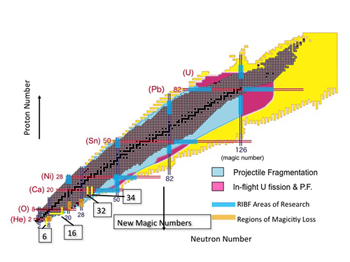
New magic numbers
1. Introduction

Slide 13
Terra incognita in nuclear chart
1. Introduction
- Stable isotopes: ~ 300
- Unstable isotopes: ~ 3,000
- Unknown isotopes: 3,000~6,000

Slide 14
RIB’s intensity
1. Introduction
~1/day
Identification
10/day
Mass
100/day
β (τ _{1/2} , P_{xn})
1/min
σ_{R} , ...
1/sec
β-γ, β-n
breakup, knockout, ...
Complexity
10/sec
COULEX
100/sec
(in)elastic scattering
β-γ-γ, β-γ-n, μ ...
10³/sec
invariant mass spectroscopy
10⁴/sec
transfer, charge exchange, ...

Slide 15
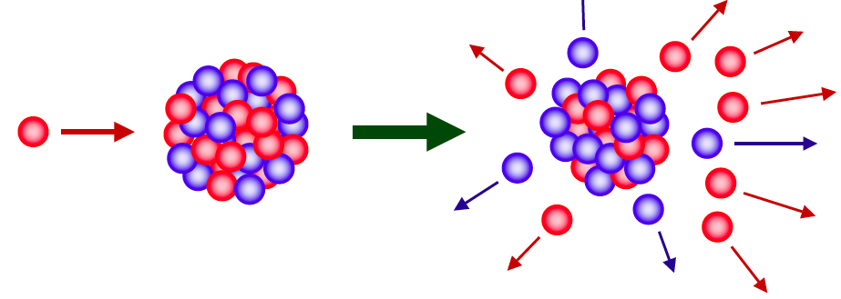
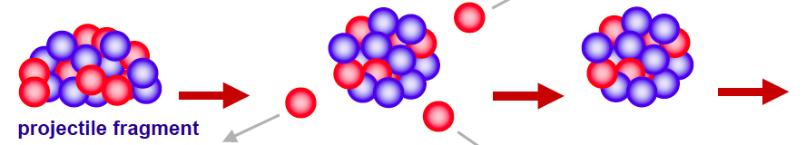
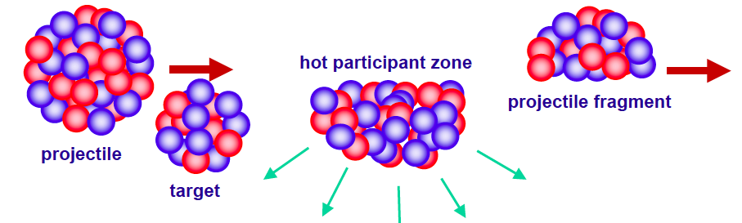
ISOL vs IF
1. Introduction
ISOL(Isotope Separator On-Line)
p → thick target (eg. Uranium Carbide) → target spallation or fission (low energy)
RI Ions
Reacceleration
RI Beam
Stopped Beam
Experiment
(Traps)
Stopping
RI ion beam
Fast Beam
Experiment
IF(In-Flight methods)
Stable Heavy ion beam → thin target → projectile fragmentation, fission,
multi-nucleon transfer reaction, …

Slide 16
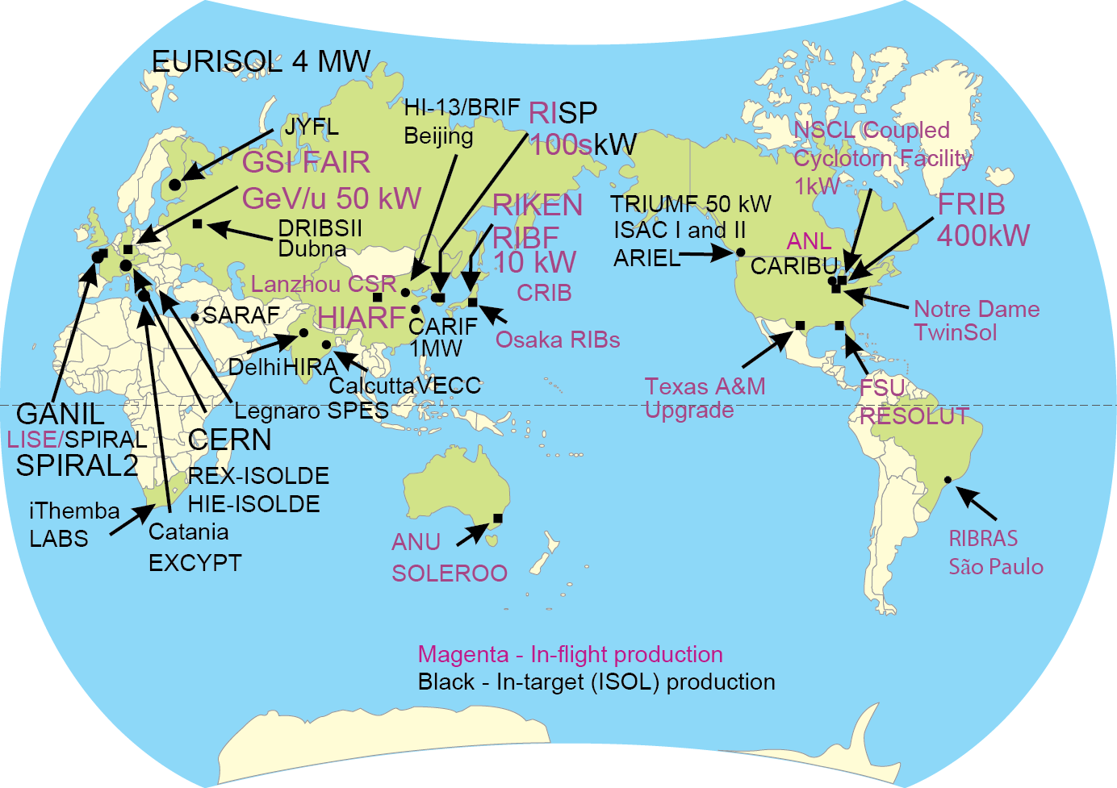
RIB facilities in the world
1. Introduction
KISS (KEK-IPNS)
Slide from B. Sherrill
RIBs : Variety, Intensity, Energy, Purity

Slide 17
Part 1.
RISP Overview

Slide 18
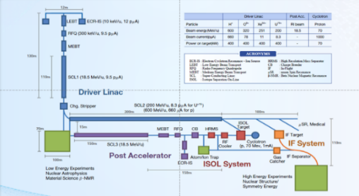
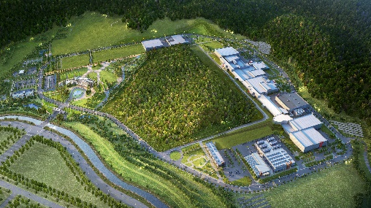
Rare Isotope Science Project (RISP)
1. Overview
Goal: To build a heavy ion accelerator complex RAON,
for rare isotope science research in Korea.
* RAON - Rare isotope Accelerator complex for ON-line experiments
Budget: KRW 1,498 billion (US$ 1.23 billion, 1$=1,209krw)
- accelerators and experimental apparatus : 502.8 billion won
- civil engineering & conventional facilities : 996 billion won (incl. site 357 billion won)
Period: 2011.12 ~ 2021.12
System Installation Project
Providing high intensity RI beams by ISOL and IF
ISOL: direct fission of ²³⁸U by 70 MeV proton
IF: 200 MeV/u ²³⁸U (intensity: 8.3 pμA)
Providing high quality neutron-rich beams
e.g., ¹³²Sn with up to 250 MeV/u,
up to 10⁹ particles per second
Providing More exotic RI beam
production by combination of ISOL and IF
Development, installation, and commissioning of the accelerator systems that provides high-energy (200MeV/u) and high-power (400kW) heavy-ion beam
Facility Construction Project
Construction of research and support facility to ensure the stable operation of the heavy-ion accelerator, experiment systems, and to establish a comfortable research environment
※ Accelerator and experiment buildings, support facility, administrative buildings, and guest house, etc.

Slide 19
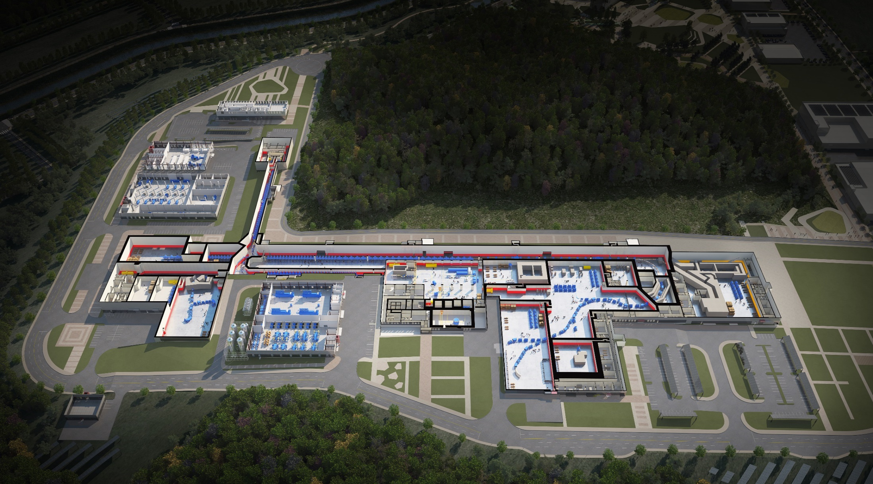

RAON Layout
1. Overview
Control
Center
Utility
SCL1
ISOL System
HPMMS/
CLS
IF System
SCL3
SCL2
BIS
ECR IS
μSR
NDPS
KOBRA
Cyclotron
HRS
LAMPS
SCL1 has been decided to postpone
: SCL3 is going to be taking a role of SCL1 in the early operation

Slide 20
RISP Organization
1. Overview
Director
Quality Control Department(4)
Deputy Director
Project coordination Department(13)
Administration Division(14)
Experimental System Division(33)
System Integration Division(21)
Superconducting Technology Division(33)
Facility Construction & Infrastructure Division(17)
- Project Policy and
Planning Team
- Project Management
Team
- HR & General
affairs Team
- Research Support
Team
- Procurement
Management Team
- Very Low Energy
Experimental System
Team
- Low Energy Experimental
System Team
- Intermediate Energy
Experimental System Team
- Beam Transport
Team
- Accelerator Control
Team
- Beam Physics Team
- SCL Team
- RF Team
- Cryogenic System Team
- Superconducting Magnet
Team
- Construction Management
Team
- Facility & Safety
Management Team

Slide 21
1. Overview
RIBs at RAON
IF
ISOL
KOBRA
ISOL+IF
RAON will provide access to unexplored regions of the nuclear chart

Slide 22
1. Overview
Project History
System Installation
Facility Construction
Project General
Jan 2012 Established Master Plan for RISP
June 2012 Submitted Basic Design Summary
(BDS)
May 2014 Finalized the Master Plan for the
Establishment of the IBS
(Heavy-ion Accelerator)
July 2014 Finalized the Implementation Plan
for the Construction of the
Heavy-ion Accelerator Facility
Dec 2014 Began the basic design of facility
construction
June 2016 Constructed the
SRF test facility
at Munji
Sep 2016 Started detail design
of facility construction
March 2018
Completed
the SCL3 HWR
prototype module
performance test
2012
2013
2014
2015
2016
2017
2018
2019
Jan 2009
Finalized the Comprehensive
Belt Plan (National Science &
Technology Commission)
June 2010
Completed the research to
establish the Heavy-ion
Accelerator Construction Plan
Feb 2011
Completed the Heavy-ion
Accelerator Conceptual Design
Dec 2011
Launched the Heavy-in
Accelerator Project
June 2013 Completed Technical Design
Report (TDR)
Sep 2013 Revised the Master Plan (1st)
(period extension (~2019),
implementation schedule
change, etc.)
April 2015 Revised the Master Plan (2nd)
(period extension (~2021),
implementation strategy
change, etc.)
Dec 2015 Completed the basic design
of facility construction
Feb 2017 Began the priority work of
facility construction
May 2017 Successfully completed
the performance test of the
SCL3 QWR module
June 2017 Completed the detail
design of facility
construction
Sep 2017 Began the facility
construction
Oct 2017 Successfully completed the
SCL demo runs
Dec 2017 Project review by TF
May 2019 Revised the Master Plan (3rd)
(scope and strategy change)
Sep 2019
Install the first QWR module

Slide 23
1. Overview
Project Milestone
(2018)
SCL3 manufacturing
SCL2 Prototype
(2019)
SCL3 Installation
SCL2 manufacturing
(2020)
SCL3 Beam Commissioning/
Const. Completion
(2021)
KOBRA operation/
Project Completion
System Installation
ECR-IS beam &
ISOL beam (SI beam)
(Dec 2015)
18.5MeV/u
SI beam
(Dec 2020)
18.5MeV/u
RI beam
(Sep 2021)
SCL demo beam
(Dec 2017)
2014
2015
2016
2017
2018
2019
2020
2021
RFQ beam
(Dec 2016)
SCL
installation
(April 2019)
ISOL
Commissioning
(July 2020)
D-1
Experiment
(Jan 2021)
SCL2
(Dec 2021)
Facility Construction
Completion of basic design
(Dec 2015)
Completion of detail design
(June 2017)
Supply of utilities
(Dec 2018)
Building
Permit
(April 2021)
2014
2015
2016
2017
2018
2019
2020
2021
Beginning of priority
construction
(Feb 2017)
Beginning of construction
(Sep 2017)
Completion of construction
(Dec 2020)
Completion of inspection of the radiation facility
(Dec 2021)

Slide 24
1. Overview
Progress Rate
1. Overview
Progress Rate
System Installation Project
As of May. 2020
(Planned: 83.20%,
Actual: 78.12%)
Construction Project
As of May. 2020
(Planned: 81.37%,
Actual: 81.40%)

Slide 25
Part 2.
Construction

Slide 26
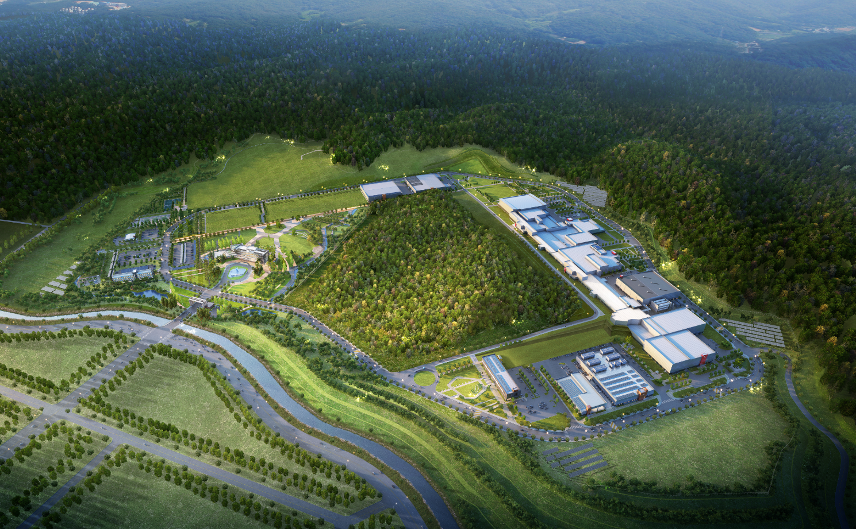
2. Construction
Building Layout
Building Layout
Campus Area : 952,066㎡ (including the reservation area of 144,640㎡)
Period : 2014 ~ 2021(8 years)
Cost : 996 billion won (incl. 357 billion won for land)
Building Area : 76,259㎡(11 Bds)
Total Bd. Area : 116,252㎡
Constructor : POSCO Consortium(11 companies)
Assembly Bd.
SRF Test Bd.
High Energy B
IF Separator / High Energy A
Waste Strorage
Cryogenics Bd.
HQ Office
Reservation
ISOL
SCL
Info. Center
Guest House
Low Energy A,B
Control Center
Utility Bd.
Electricity Bd.

Slide 27
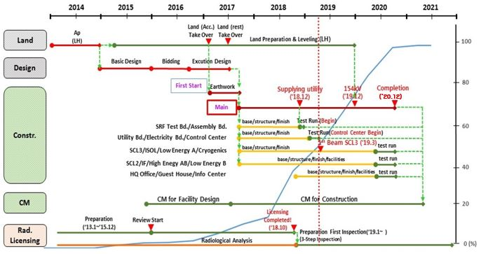
2. Construction
Construction Schedule
Construction Schedule

Slide 28
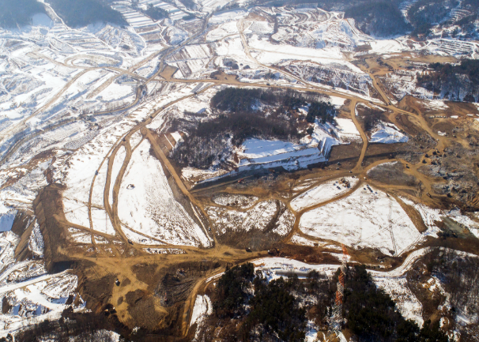
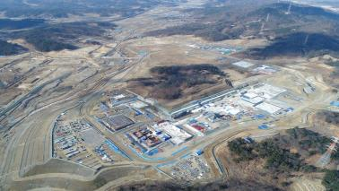
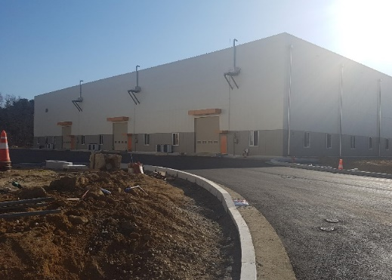
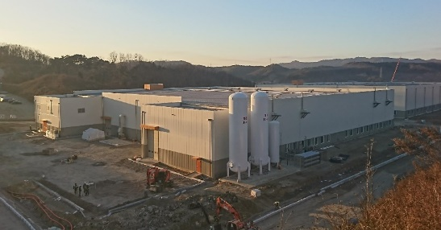
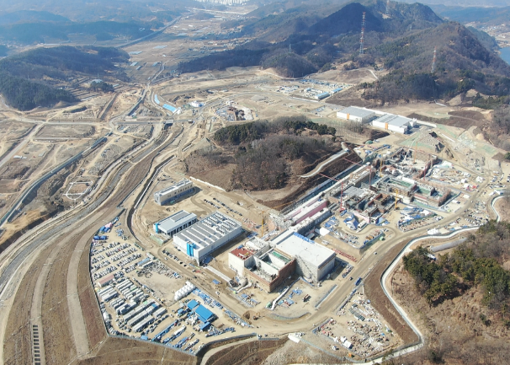
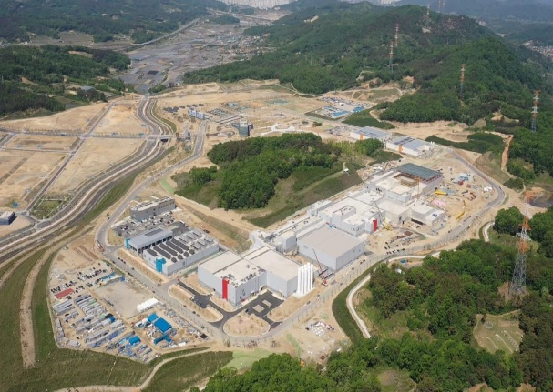
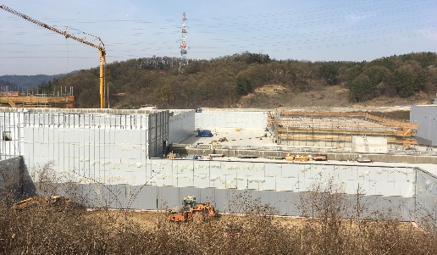
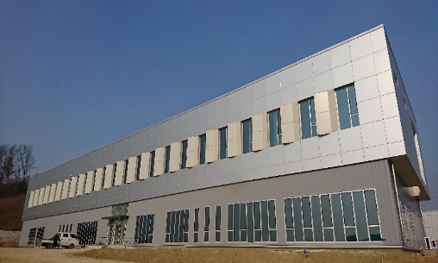
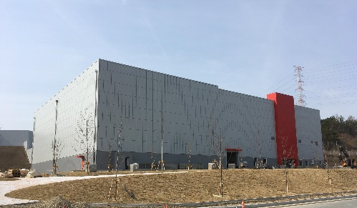
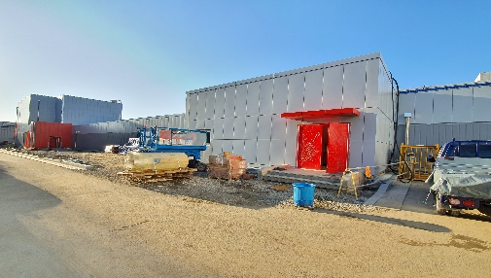
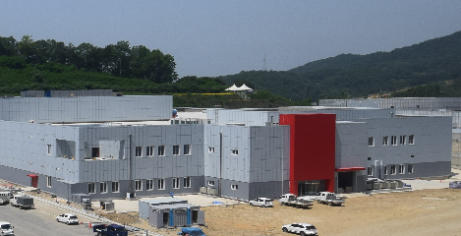
2. Construction
View of Construction Place
View of Construction Place (`20.04)
<Assembly Bd.>
<`17.01>
<`18.01>
<SRF Test Bd.>
<`19.01>
<`20.04>
<High Energy Exps.>
<Control Center>
<Low Energy Exps.>
<SCL3>
<ISOL>

Slide 29
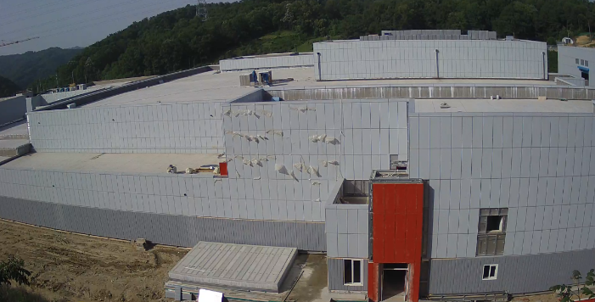
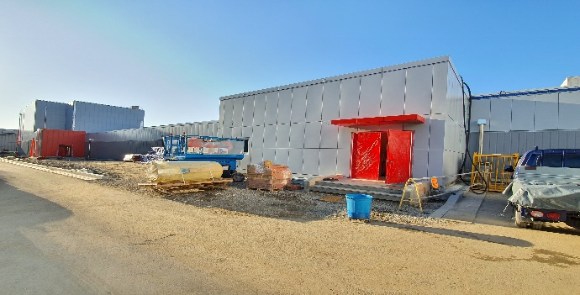
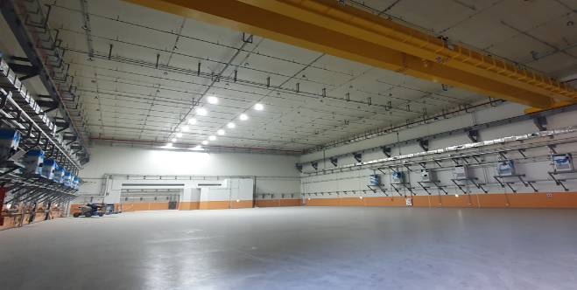
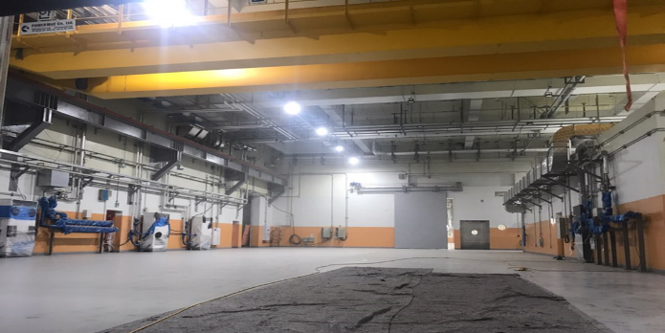
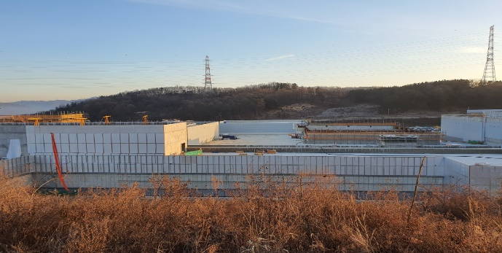
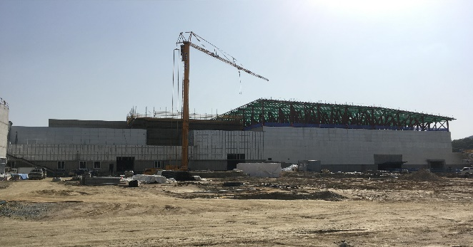
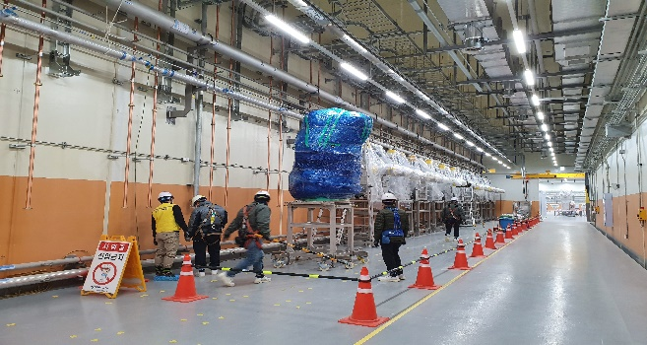
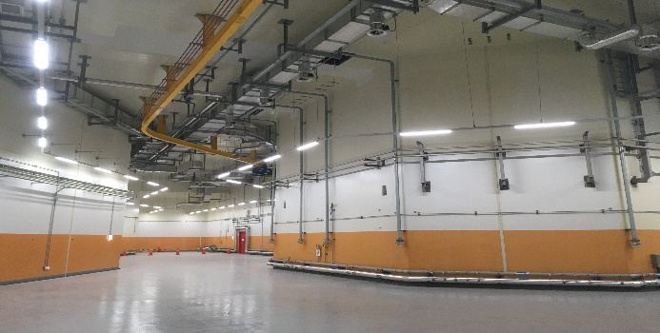
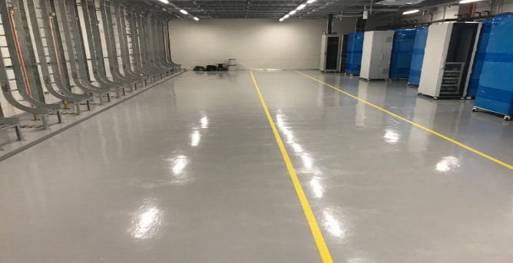
2. Construction
Conventional Facilities
SCL2
SCL3
Low Energy A/B
ISOL
IF/ High Energy A
High Energy B
SCL3
Bending Section
SCL3-gallery
Accelerator Bd.

Slide 30

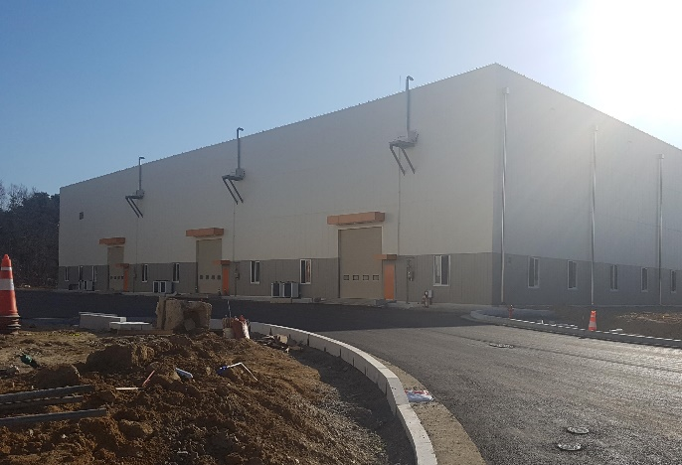

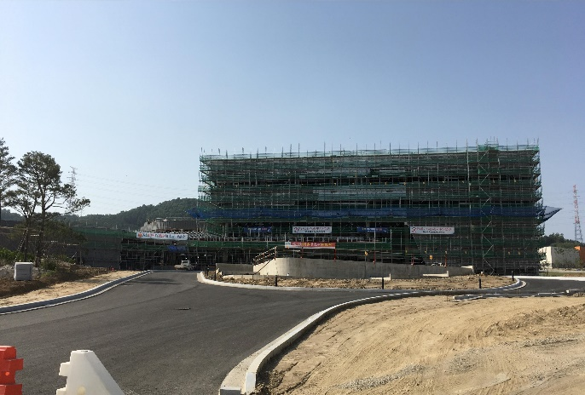
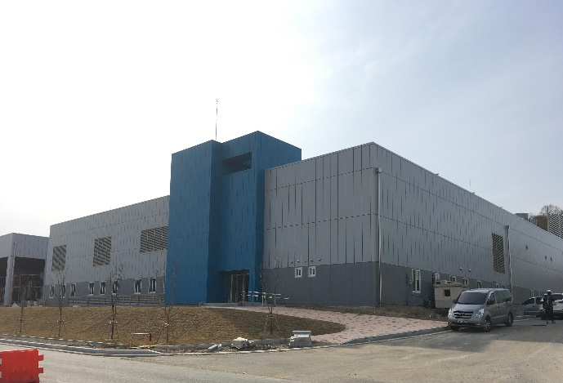
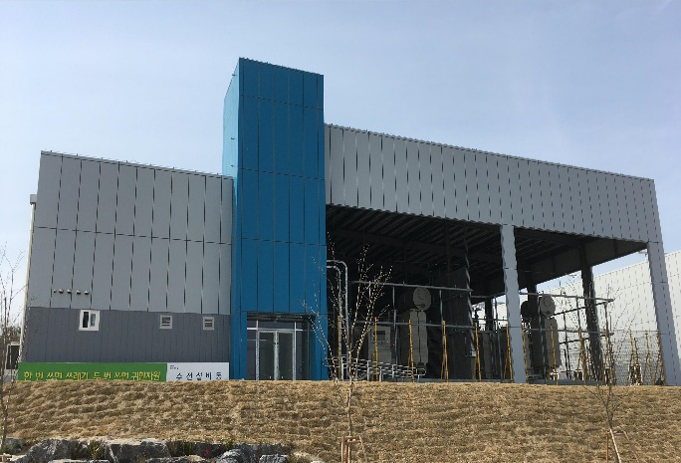
2. Construction
Conventional Facilities
SRF Test Bd.
Assembly Bd.
Control Center
HQ Office Bd.
Utility Bd.
Electricity Bd.

Slide 31
Part 3.
System Installation

Slide 32




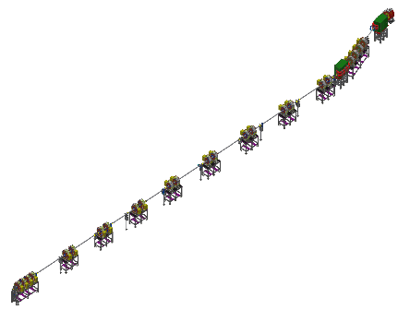
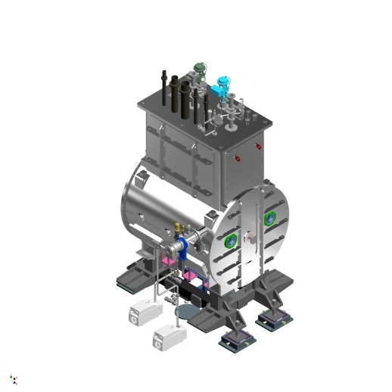
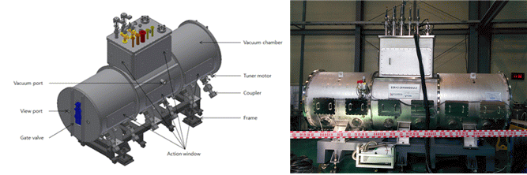
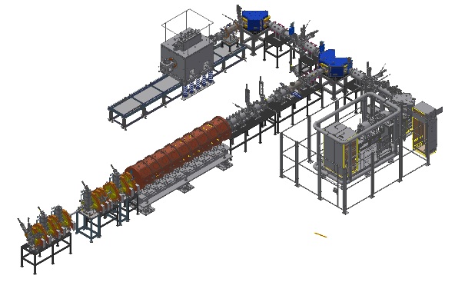





3. Sys. Install.
Accelerator System
KoBRA Beam Line
SCL2(SSR1)
SCL2(SSR2)
Injector
SCL3
(HWR)
SCL3
(QWR)
Cyclotron
IF System

Slide 33


3. Sys. Install.
Accelerator System

Slide 34

3. Sys. Install.
Accelerator System

Slide 35


3. Sys. Install.
Accelerator System
Until September `2020

Slide 36

3. Sys. Install.
Accelerator System
Until September `2020

Slide 37

3. Sys. Install.
Accelerator System-QWR unit
QWR Cryomodule
Valve Box
Warm Section

Slide 38






3. Sys. Install.
Accelerator System - Injector
Injector
SC ECRIS
∙ Two ECR ion sources on high voltage platforms
14.5 GHz ECR ion source
28 GHz superconducting ECR ion source
∙ LEBT (E = 10 keV/u)
Beam energy – 10 keV/u, Dual bending magnet
Chopper & Electrostatic quads, Instrumentation
∙ RFQ (E = 500 keV/u)
Frequency 81.25 MHz, Transmission Eff. ~98%
CW RF Power 94 kW (SSPA: 150 kW)
∙ MEBT (E = 500 keV/u)
Four RF bunchers (SSPA: 20, 15, 4×2 kW)
Simple quadrupole magnets, Instrumentation
LEBT
ECRIS
MEBT
RFQ
SC ECRIS commissioning
RFQ commissioning
∙ Beam experiment for the performance enhancement
∙ Basic metal beam experiment
∙ RFQ has been conditioned to 40kW, sufficient to
accelerate A/q=4.5 beams
Amplitude control of RFQ
Ar beam experiment
Charge distribution
QWR CM
ECRIS
Ar 11+ 70uA
RFQ
Output Energy of RFQ(TOF)
~508keV/u

Slide 39








3. Sys. Install.
Accelerator System – SCL3
SCL31(QWR)
∙ Design performance was achieved with prototypes(2017.5)
∙ Oxygen beam was accelerated with injector and one QWR module(2017.10)
500 keV/u → ~700 keV/u, Successful long-tem operation of cryomdoule
∙ Mass production was contracted with domestic vendor(2017.12)
Pre-production cavities and cryomodules passed qualification, mass production is on-going
Total thermal load <20W@6.1MV/m, 4.2 K
VT target: 2.4e+8@6.1MV/m
RF System
∙ SSPA (4kW) : 2018.07~2020.05
Pre-production performance test(2019.11)
∙ HPRF transmission line (1-5/8”)
Installation vertical parts (2019.10)
∙ LLRF control system (2019.07~2020.06)
∙ RF reference line (81.25MHz) : ~2019.12
Static thermal load: 5.8 W
(Target: max. 7.5 W)
SCL32(HWR)
∙ Design performance was achieved with prototypes(2017.10)
Thermal load <14.1W@6.6MV/m, 2.1 K (HWR type A)
∙ Mass production was contracted with domestic vendor(2018.5)
QWR
HWR#A
HWR#B

Slide 40
3. Sys. Install.
Accelerator System – QWR
VT target: 2.4e+8 at 6.1 MV/m

Slide 41

3. Sys. Install.
Accelerator System – HWR
VT target: 2.3e+9 at 6.6 MV/m

Slide 42


3. Sys. Install.
Accelerator System – QWR HT
CM-#2
CM-#5
 | Total (W) | Static (W) | Dynamic (W) | Q₀ of cavity
QWR-CM-#1 | 11.7 | 7.7 | 4.0 | 6.0e+8
QWR-CM-#2 | 10.8 | 8.0 | 2.8 | 8.5e+8
QWR-CM-#3 | 13.1 | 8.4 | 4.7 | 5.1e+8
QWR-CM-#5 | 14.4 | 9.5 | 3.5 | 6.6e+8
All tested cryomodules meet the total thermal load requirement (20 W) though the cryomodules did not thermalized.
NO significant performance degradation of cavities during cryomodule assembly.

Slide 43







3. Sys. Install.
Accelerator System – SCL2
SCL21(SSR1)
∙ 1st prototype was performed by TRIUMF(2019.6)
Balloon type(less multipacting, better mechanical characteristics)
Accelerating gradient over 8.7MV/m, Multipacting below 2MV/m
∙ 2nd prototype with domestic vendor is on-going
RF System
∙ SSPA (8, 20 kW): 2020.01~2021.06
Requirement for RF power rating
∙ HPRF transmission line
3-1/8”, 4-1/16” rigid coaxial
∙ LLRF control system (2020.04~2021.06)
∙ RF reference line (81.25MHz) : ~2020.12
1st prototype by TRIUMF
2nd prototype by domestic vendor
SCL22(SSR2)
∙ 1st prototype of cavity is on-going
Designed by RISP, fabricated by domestic vendor
Balloon type, Deep drawing (depth ~280mm)
∙ 2nd prototype with IHEP is on-going
Cylindrical type
RISP design(balloon type)
SSPA Prototype
SSR1

Slide 44









3. Sys. Install.
Major achievements in R&D
Achievement of low temperature test for LTS and HTS quadrupole prototype magnet (LTS 2017.11, HTS 2017.2)
QWR cryomodule test complete
(2017.05)
1st Oxygen Ion beam acceleration with RFQ(2016.12)
HWR cryomodule test complete
(2018.03)
1st Oxygen Ion beam acceleration with a QWR module, SCL Demo(2017.10)
High purity Sn beam extraction
using RILIS (2015.12)
Superconducting RF Test facility(2016.06)
ECR IS
RFQ
QWR
LEBT
MEBT

Slide 45






3. Sys. Install.
Beam Physics
Start-to-end simulation: uranium (²³⁸U^{33+,34+→77+,78+,79+,80+,81+})
Physics application tools
SCL3
SCL2
SCL2 extension
Transverse beam size
Longitudinal beam size
On-line orbit correction
BIPAM (Beam Input Parameter And Matching)
CAPS (Cavity Amplitude and Phase Scan)

Slide 46



3. Sys. Install.
Beam Physics
Injector beam commissioning
Period: 2020. 03 $\sim$ 2020. 09
Section: 14.5 GHz ECR-IS → LEBT → RFQ → MEBT
Reference beam: ⁴⁰Ar⁹⁺ or O (50 μs pulse beam, $≤$1Hz repetition rate)
MEBT
RFQ
LEBT
LEBT
Charge selection
Emittance measurement $→$ beam distribution regeneration
Transverse beam size measurement
Orbit correction
Pencil beam test, etc.
RFQ
Beam transmission
Beam energy measurement, etc.
MEBT
Rebuncher amplitude & phase scan
Transverse beam matching
Longitudinal beam matching
Orbit correction, etc.
14.5 GHz ECR-IS

Slide 47












3. Sys. Install.
Control System
Control Center
Integrated Control System
Timing System
Fast Protection System
Local Control System
Main Control Room
Data Storage System
EPICS IOC
Controllers
SCL3 Control System(43)
Beam Diagnostics Control System

Slide 48



SCL3 Warm Section – Chamber and magnets
3. Sys. Install.
Diagnostic chamber
∙ 15 sets were already fabricated.
- BPMs, Wire scanners and Faraday cups
∙ Need to assemble in the clean condition
Vacuum chamber
∙ 53 sets were are already fabricated.
- NEG pumps and gauges
∙ Need to assemble in the clean condition
Magnets

Slide 49





3. Sys. Install.
Installation Procedure
Alignment network Survey (2019. 4 ~ )
Transportation to the accelerator building

Slide 50




3. Sys. Install.
Installation Procedure
Warm section assembly
Rinse
Dry
class 100
Assemble
class 10
Leak check
class 100
(150℃, 120h)
Conditioning

Slide 51


3. Sys. Install.
Installation Procedure
Cryomodule + Warm section
∙ Assemble in front of the tunnel (ISOL building)
∙ 15-ton crane is available.
∙ Need to connect between cryomodule and warm section in the clean condition

Slide 52



3. Sys. Install.
Installation Procedure
Transport and positioning in the tunnel
∙ To prevent alignment change due to vibration
∙ To transport 10-ton HWR-B cryomodul in the tunnel
∙ For fine positioning
Impossible to use wheels
Adopting air caster

Slide 53

3. Sys. Install.
Installation Procedure
Launching celebration of the 1st QWR cryomodule installation

Slide 54


3. Sys. Install.
Installation Procedure
(Cryomodule + Warm section) + (Cryomodule + Warm section)
∙ At least one port should be assembled in the tunnel
∙ Difficult to make clean conditions due to the tight space
∙ Design a simple clean booth is underway

Slide 55





3. Sys. Install.
Control System
Control Center
Integrated Control System
Fast Protection System
Timing System
Local Control System
15m
Display Wall
Beam Diagnostics Control System
Data Storage System
SCL3 Control System
Embedded EPICS IOC Controller

Slide 56

















3. Sys. Install.
RI & Experimental System
Bio-medical facility
Neutron Facility
HPMMS
CLS
mSR
Low Energy Exp. Bldg
Ultra-low Exp. Bldg
High Energy Exp. Bldg
ISOL
KOBRA
IF
LAMPS

Slide 57





3. Sys. Install.
Cryogenic System
Tasks | 2019 |  |  |  |  |  |  | 2020
 | 6 | 7 | 8 | 9 | 10 | 11 | 12 | 1 | 2 | 3 | 4 | 5 | 6 | 7 | 8 | 9 | 10 | 11 | 12 | 1
SCL3 Cryoplant (4.2 kW) SCL2 Cryoplant (13.4 kW) Cryogenic Distribution System (SCL3)
Design and Fabrication
Installation and Inspection
Commissioning
Design and Fabrication
Installation & Inspection
Commissioning
Fabrication (QWR)
Fabrication
(HWR and transfer line)
Prototype test
Installation (valve boxes)
Installation (transfer line)
SCL3 Commissioning
Now
Connection
( Valve Box – Cryomodule )
Inspection
and connection with cold box
15 m
19.5 m
SCL3 Cold Box (95 ton)
SCL2 Cold Box (130 ton)
QWR Valve Box
(Prototype and installation test)

Slide 58


3. Sys. Install.
ISOL system
TIS.L→ Pre-sep → HRMS → user
TIS.R→ Pre-sep. → Mass sep. → HRMS → user
TIS→ Pre-sep. → HRMS → EBIS → a/q→post acc.
Test Facil. (low pow., non U) → Pre-sep → user
Now concentrating on the shortest line
TIS.L → Pre.sep → EBIS → A/q → Post.acc
A/Q separator line
Branch point
MMS
RFQ-c/b + EBIS
ISOL building ready by ‘19.12
- Ground floor: TIS, beamline,
experimental hall
- 1st floor: experimental hall, Laboratory, utilities
- 2nd floor: Control room, Analysis room
Line 1
HRMS
Line 2
Early stage operation
Bunker-L
Bunker-R
pre-mass separator room L
TIS-L
TIS-R
pre-mass separator room R

Slide 59

3. Sys. Install.
IF system
In-Flight separator layout

Slide 60

3. Sys. Install.
Layout of Experimental System at RAON
Nuclear science - KOBRA, LAMPS, NDPS, MMS, CLS (based on atomic physics)
Applied science - μSR (Material science), BIS (Bio & Medical application)
7 (at the beginning of RAON operation) + upgrade + α (in the future, space reserved)

Slide 61










3. ACC. & Exp.
Current Status of Experimental System
3. Sys. Install.
1. KOBRA
(KOrea Broad acceptance Recoil spectrometer & Apparatus)
∙ Research Studies of nuclear structure and nuclear
astrophysics in the energy range of < a few tens of MeV/u
∙ Current status Under fabrication (start installation from Sep. 2019)
2. LAMPS
(Large Acceptance Multi-Purpose Spectrometer)
∙ Research Studies of nuclear matter and nuclear reactions
with stable and RI beams at intermediate energy regime
∙ Current status Under fabrication (start installation from Jan. 2021)
IF separator

Slide 62








3. ACC. & Exp.
Current Status of Experimental System
3. Sys. Install.
3. MMS (Mass Measurement System)
4. CLS (Collinear Laser Spectrometer)
5. NDPS (Neutron Data Production System)
∙ Research High precision mass measurement of
short lived rare isotopes
∙ Current status Under assembly and test
(start installation from Feb. 2020)
∙ Research Model independent Studies of
nuclear ground and isomeric state properties
∙ Current status Restart development
(start installation from Jan. 2020)
∙ Research Measurement of neutron
induced reaction data for nuclear science
∙ Current status Restart development
(start installation from Jan. 2021)
MR-TOF-MS
6. μSR (Muon Spin Rotation/Relaxation/Resonance )
7. BIS (Beam Irradiation System)
∙ Research Studies of local electromagnetic structures and
exotic properties of material by using polarized muons
∙ Current status Restart development
∙ Research Biomedical studies such as cancer treatment,
human body effect by space radiation and cell mutation
∙ Current status Restart development
(start installation from Nov. 2020)
(start installation from Feb. 2021)

Slide 63



3. Sys. Install.
KOBRA
Goal: Construction of multi-purpose experimental instrument using stable or RI beams for studies of the nuclear structure and nuclear astrophysics, in the energy range of about 1 – 30 MeV/u
RI beam productions at a few MeV/u and at about 20 – 40 MeV/u using a stable beams from ECR ion source
Recoil mass separator at less than few MeV/u for direct measurements of radiative-capture cross, using a RI beams from ISOL facility
2018.08
SCL1
Low energy experimental hall B
SCL2
SCL3
Spallation room for future extension
Ions are accelerated
up to about 40 MeV/u for A < 40,
up to about 20 MeV/u for A > 100
IF facility
High energy experimental hall B
ISOL facility
High energy experimental hall A
Low energy experimental hall A
KoBRA

Slide 64









3. Sys. Install.
KOBRA
Swinger
F3
5 m
F1
Contracted on Dec 2018
F2
Wien Filter will be added later
Small quadrupole magnet
Contracted on April 2018
Consortium
((Korea)
Project management
F0
Sextupole magnet
(Denmark)
Project management
Designs of all magnets
Productions of bending magnets and swinger
Removable scattering chamber
Empty space for Si-detector array
or IC chamber
((Korea)
Productions of quadrupole and sextupole magnets
(Korea)
Designs and productions of diagnostic chambers, beam pipe, beam dump, and etc.
F3 chamber
F2 chamber
F1 chamber

Slide 65








3. Sys. Install.
KOBRA
PPACs
SSD
PPACs
• Six 10 x 10 cm², two 20 x 20 cm², two 40 x 20 cm² active area PPACs
• Position resolution: < 1 mm in FWHM, (C₄H₁₀ gas, ¹⁶O beam at 2x10⁶ pps)
Large area PPACs
Use Bρ-ToF-∆E technique for RI identification
HPGe gamma array
Plastic scintillator detectors
• One 10 x 10 cm² active area, 100 μm thick both side readout plastic detector
• One 10 x 10 cm2 active area, 100 μm thick one side readout plastic detector
• Time resolution < 42 ps for 5.486 MeV α in vacuum
HPGe gamma ray detectors
• 32 segmented HPGe detectors (6set)
• Compton suppressor BGO crystals (6set)
• Complete set of TIGRESS electronics
SSD
• Two 5 x 5 cm² active area, 50 μm-thick, 16 channel SSD
• Energy resolution ~ 0.7%, S/N ~ 272 for 5.486 MeV α in vacuum
• All of detectors are fulfilled KoBRA detection system requirements
• Complete KOBRA detection system including spare detectors, Ion Chamber, HPGe gamma array and DAQ system will be
ready by the middle of 2019

Slide 66

3. Sys. Install.
LAMPS
Main facility for nuclear matter and nuclear reaction studies with stable and rare isotope beams at intermediate energy
• Main Research Subject
Study of nuclear symmetry energy at supra-saturation density via heavy-ion collision experiment using rare isotope beam with varying beam energies and collision systems
(e.g. measure n/p ratio & collective flow at the same time in the combination of ^{50,54}Ca+⁴⁰Ca, ^{68,70,72}Ni + ⁵⁸Ni,
^{106,112,124,130,132}Sn + ^{112,118,124}Sn)
▪ Beam Energy: up to 250 MeV/u for ¹³²Sn (≤ 10⁸ pps)
▪ Solenoid Spectrometer
- Max. 1T solenoid magnet
- TPC (~ 3π sr acceptance, charged particle tracking)
- Scintillation counter (trigger & ToF)
▪ Neutron Wall (neutron tracking)
IF separator

Slide 67

3. Sys. Install.
LAMPS
Fine tuning on the design parameters by experts
Cylindrical SC magnet
Dim.: 3300 mm (L) $×$ 2200 (W) $×$ 2600 mm (H)
Fit into the pit
Diameter of bore = 1600 mm
Max. $B$-field > 1 T
Variation of $B$-field over TPC volume = ±0.94%
Passive quench protection
Conduction cooled with 4K vessel thermal shield and vacuum vessel
Contracted with Tesla Engineering Ltd. UK by RISP magnet⁃vacuum R&D group in Feb. 27, 2019
Production design is ongoing

Slide 68



3. Sys. Install.
LAMPS
Drift length = 1200 mm
Pad dim.: ~ 3$×$10 mm²
# of Ch.: 2,618/sector $×$ 8 sectors = 20,944
FEE: 11 AsAD/sector $×$ 8 sectors = 88 AsAD
Final design of readout, gas vessel, and field cage is in progress
Readout will be only at the upstream end
P20 gas with $v_{drift}$ > 6 cm/µs meets entire readout time of GET electronics over full drift length (120 cm)
Octagonal outer barrel and circular inner barrel
Inner radius: 150→100 mm, Outer radius: 500→535 mm
Maximize the active region for R = 105 ~ 503.5 mm
Test of the real-size GEM foil is underway
If gain is too small, an option for quadruple GEMs may be explored
LAMPS TPC will be constructed in 2019 and tested by 2020

Slide 69



3. Sys. Install.
LAMPS
Installation of all modules (160 neutron detectors + 20 veto detectors) in the frame were completed in December, 2018
Preparation of cosmic muon test is almost ready
Detector operation will be done remotely at Korea University Lab. in Seoul

Slide 70



3. Sys. Install.
MR-TOF
Connection with CLS is now on the discussion
Low energy beam of < 60 keV
Differential pumping stage
Windowless helium gas catcher
Trap and bunching system
MRTOF reflection chamber

Slide 71






3. Sys. Install.
MR-TOF
MR-ToF-MS can provide a high mass resolving power of > 10⁵ even with short measurement time of 10 ~ 30 msec
It is more suitable for the short-lived nuclei region
“Fast and Precise”
Mass measurement, but also Beam purification
Mirror electrodes
1: mass of interest
2: mass of reference

Slide 72
Scientific program at early phase operation(candidate)
3. Sys. Install.
Facility | Subject for early phase operation
KOBRA | ∙ Transfer reaction measurements in inverse kinematics (²⁹P(d,p)³⁰P, ²⁶Al(α,p)²⁴Si) ∙ Radiative capture reactions using batch mode RI beams (^{26g}Al(p,γ)²⁷Si) ∙ RI beam production via quasi-projectile-like fragmentation for ¹⁶O or ⁴⁰Ar
LAMPS | ∙ Ar+KCl or Xe+CsI in case of IF separator commissioning not completed
MMS | ∙ Isomer separation with using ^{26g.s.}Al and ^{26m}Al beams
CLS | ∙ Laser ionization and measurement of isomeric property for ²⁶Al
NDPS | ∙ Activation experiments with a quasi mono energy neutrons for light and heavy nuclei ∙ Surrogate reactions for fission
μSR | ∙ One of research areas of superconductivity and quantum magnetism with their scientific significance at the time of the μSR instrument completion
BIS | ∙ Physical dose distribution and linear energy transfer measurements with a ¹²C⁺⁶ beam (310 MeV/u)

Slide 73








3. Sys. Install.
International Cooperation (MOUs with 18 Intl Institutes)
27

Slide 74
Part 4.
Radiation Safety

Slide 75
4. Rad. Safety
Radiological Features of the Facility
High Power Targets
IF : 400 kW, ISOL : 30 ~ 70 kW
induce high activation in concrete, air, cooling water, machine parts
need robust remote handling in target areas
Use of Uranium Material
fission products contaminate ISOL target system, IF beam dump, etc.
generation of radioactive waste containing actinides-> need a long-term storage space of the waste until ready to transfer to the national site
Various Reactions to analyse
Experiments | Beams | Targets
IF | O, Ca, …, Kr, .., Sn, Xe, U, ~20 species | C
ISOL | p | UC
KOBRA | He, B, O, Ar, U | Be, Cu
Bio-medical | C | Fe
muSR | P | C
LAMPS | Ca, Ni, Zr, Sn | Ca,….
Neutron Exp. | p, d | C
various beam and target combination
wide energy range (low 18~40MeV/u, high 200~320 MeV/u, 600 MeV p)
need to find correct simulation codes and conditions

Slide 76

4. Rad. Safety
Radiation Safety Licensing : Completed!! (18.10)
Preparation
many domestic experts joined radiological analysis
facility basic design by a experienced company
Documents for Review
radiation safety report
(shielding, activation, env. Influence, RMS/PSIS,
exhaust, accident analysis, radioactive waste, etc..)
description of accelerators and experiments
details in radiological analysis (codes, input/output)
geological survey report
stability assessment of building and ground
quality assurance plan/procedures
fire hazard analysis
NSSC
(Nuclear Safety and Security Commission)
Extensive Reviews
License Submission
& Approval
Technical Review Request
& Review Report
by more than 30 KINS reviewers
382 cases of answers/further assessment/correction/design improve and changes
multilevel review(KINS, NSSC, Advs..)
RISP
Technical Detail
Inquiry & Answer
KINS
(Korea Institute of Nuclear Safety)

Slide 77
4. Rad. Safety
Plan – First Facility Inspection
mandatory step before operation (every year after the first inpection)
’19 |  |  |  | ‘20 |  |  |  | ‘21
1Q | 2Q | 3Q | 4Q | 1Q | 2Q | 3Q | 4Q | 1Q | 2Q | 3Q | 4Q
Arranged with KINS
to make 3-steps inspection
Ion Source,
Injector
SCL3, KOBRA
ISOL,SCL2+IF, h.e.Exps
check items
RMS Equipments in the site
Environment Monitor | 12
Area Monitor | 94
Area Air Monitor | 11
Stack Monitor | 6
Hand & Foot Monitor | 11
Nuclide Analyser | 6
Paging Phone | 88
CCTV camera | 101
Emergency Stop & Alarm | 174
Vehicle Radiation Monitor | 2
safety organization / manpower
record of quality assurance activity
performance of all RMS & PSIS systems
implementation of fire protection
performance of exhaust/draining/remote system
readiness of preventive and mitigative measures for possible accidents of more once in 30 years
procedures to handle radioactive wastes
etc..
Safe Facility for workers & vistors & citizens !

Slide 78
Part 5.
Summary & Outlook

Slide 79
4. Summary
Summary & Outlook
Accelerator
Mass production for SCL3 is under way and SCL2 is under pre-production stage.
Beam commissioning for the injector begins in the spring 2020.
From April, 2019, installation for SCL3 has been started and will completed by the end of 2020.
By the end of 2021, we will achieve
SI beams: Stable ion beams (¹⁶O, ⁴⁰Ar) from ECRIS → SCL3 → low E exp hall
RI beams: RIBs extraction from ISOL → re-acceleration through SLC3 → low E exp hall
Stable / RI beams will be delivered to low-E experimental hall
Early phase experiments are going to be performed using KOBRA
RIBs production at KOBRA (A<~50, beam energy < 20 MeV/u) using SI beams from SCL3
Beam commissioning begins for SCL2
Installation and commissioning for IF, LAMPS, Neutron, bio-medical and μSR
→ Collaborative works with RUA (RAON Users Association) via RULC (RAON Users Liason Center)
Post RISP (2021 ~ )
Beam acceleration for ISOL → SCL3 → SCL2 → IF (ISOL+IF)
Beam commissioning and experiments for IF, LAMPS, Neutron, bio-medical and μSR
Ramping-up to get the 400kW beams (more than 5 yrs)
Energy upgrade to 400MeV/u (requires budget)

Slide 80

Thank you

Slide 81
Backup slides

Slide 82






Sys. Install.
ISOL system
10 kW Ucx target system design
Temperature of the target
Temperature of the chamber
Thermal stress of the target
Proton Beam
Energy | 70 MeV
Power | 10 kW
Beam size | 45 mm
Target
Material | UCx
Density | 2.5 g/cm³
U weight | 101 g
# of disk | 19
Disk thickness | 1.3 mm
Disk diameter | 50 mm
Total length | 22 cm
In-target fission rate
Temperature distribution
Maximum thermal stress
Release time of ¹³²Sn
benchmarking SPES 8 kW target system
Expected In-target fission rate
= 1.6×10¹³/s

Slide 83





Sys. Install.
ISOL system
ISOL Test Facility
Ion beam extraction experiment
SIS: Cs and Rb ion beam extraction
RILIS: Sn ion beam extraction
Ionization efficiency measurement
Mass resolving power M/ΔM > 400
Emittance measurement

Slide 84


Sys. Install.
ISOL system
Hot cell : TIS replace, maintenance
- four manipulator, two module driving system, TIS exchange device
- TIS chamber insert to pail and the pail move to storage
Remote crane for module & TIS transfer
- three hoist : 20 ton(module transfer & shield block removal) / 7 ton(TIS pail transfer) / 7 ton(maintenance)
- position accuracy : < 5 mm
On manufacturing
< Remote crane & interface system >
< Hot cell & remote handling system >

Slide 85






Sys. Install.
Alignment and Assembly of RAON EBIS
SC solenoid (6T)
Test ion source (Cs¹⁺)
Ion trap region
E-gun/Collector
Ion transport line

Slide 86


Sys. Install.
Alignment and Assembly of RAON EBIS
EBIS short pulse(10us) e-beam extraction experiment
• Magnetic Field : 2T
• Cathode voltage: -5.5kV → -6kV
• Cathode heater: 85W
• Gun coil: 200 → 170A, Collector Coil: 130 → 140 A
• 52nd Shot: 516mA → 416mA (81%) @ Vpp = 9.5kV
• Collector conditioning with 3 Hz
Apertures
Cathode
Collector
52nd shot

Slide 87





Sys. Install.
ISOL system
TIS Bunker/Module
Hot Cell
Remote Handling
RH Mock-up

Slide 88




Sys. Install.
IF system
Magnet to be combined with IF slide

Slide 89


Sys. Install.
MR-TOF
Differential pumping section : 450L/sec x 2, two rooms (w/ ⌀ 8 mm aperture)
Gas catcher : ⌀2 mm aperture, ⌀190 mm x 250 mm (cylindrical), RF carpet + DC cylinder
Triplet trap system : Linear Paul trap x 2, Flat trap x 1
MRTOF analyzer : Au-plated Al electrodes (18), 520 mm (including base)
Others : quadrupole ion guide, channeltrons x 3, IS x 2
Performance test for individual parts is completed
Tuning of total system is ongoing

